Slide 1
Severance tax
Ernst & Young LLP
Texas and Oklahoma
COPAS San Antonio
October 2024 meeting

Slide 2
Disclaimer
This presentation is © 2024 Ernst & Young LLP. All Rights Reserved. No part of this document may be reproduced, transmitted or otherwise distributed in any form or by any means, electronic or mechanical, including by photocopying, facsimile transmission, recording, rekeying or using any information storage and retrieval system, without written permission from Ernst & Young LLP. Any reproduction, transmission or distribution of this form or any of the material herein is prohibited and is in violation of US and international law. Ernst & Young LLP expressly disclaims any liability in connection with use of this presentation or its contents by any third party.
Views expressed in this presentation are those of the speakers and do not necessarily represent the views of
Ernst & Young LLP.
This presentation is provided solely for the purpose of enhancing knowledge on tax matters. It does not provide accounting, tax, legal or other professional advice because it does not take into account any specific taxpayer’s facts and circumstances.
Neither EY nor any member firm thereof shall bear any responsibility whatsoever for the content, accuracy or security of any third-party websites that are linked (by way of hyperlink or otherwise) in this presentation.

Slide 3




1
Overview of severance tax
15 Mins
2
Texas severance tax
Overview
Reporting requirements
Market value
Marketing costs
30 Mins
Today’s
agenda
3
Oklahoma severance tax
Overview
Legislative changes
Marketing costs
30 Mins
4
Tax reimbursement language
5
Texas exemptions

Slide 4
Overview of severance tax
Severance tax is a state tax imposed on the production of oil, natural gas and other natural resources.
Severance tax rules can vary significantly by state.
The tax is typically calculated based on the resource value.
States charge severance tax because of the idea that the resources extracted from the ground will not be replenished.
There is a variety of exemptions imposing lower tax rates, or no taxes at all, on certain types of oil and gas production.
WA
MT
ND
ME
OR
MN
VT
NH
ID
SD
WI
NY
MA
WY
MI
CT
NV
NE
IA
OH
PA
NJ
CA
UT
IL
IN
DE
CO
KS
MO
WV
VA
MD
KY
NC
AZ
NM
OK
AR
TN
SC
MS
AL
GA
AK
TX
LA
FL
HI
Production volume tax
Production value tax

Slide 5
State severance tax rates
State | Oil severance tax rate | Natural gas severance tax rate | Exemptions and incentives
Arkansas | 5% of market value for oil | 5% of market value | High-cost gas (HCG); stripper wells (SWs); marketing cost (MC)
Colorado | 2% - 5% of gross income, with rates increasing as income increases | 2%-5% of gross income, with rates increasing as income increases | SW; ad valorem credit; MC
Kansas | 8% of gross value | 8% of gross value | Low-producing (LP); lease use (LU); vented or flared
Louisiana | 12.5% of value at the wellhead | 9.8 cents per MCF (thousand cubic feet) | SW
Michigan | 6.6% of gross value | 5% of gross value | SW
Mississippi | 6% of market value | 6% of market value | Enhance oil recovery (EOR) wells
Montana | 9% of gross value | 9% of gross value | SW; EOR; MC
New Mexico | 3.75% of market value | 3.75% of market value | Royalty deductions; MC
North Dakota | 5% of gross value | 5% of gross value | SW; incremental production from secondary and tertiary recovery wells; MC
Oklahoma | 7% of gross value | 7% of gross value | Qualified new production; MC
Texas | 4.6% of market value | 7.5% of market value | LP; HCG; MC
Utah | 3% of market value under $1.50/MCF; 5% above $1.50/MCF | 3% of market value under $13.00/BBL; 5% above $13.00/BBL | EOR; new wells; wildcat wells; SW; workovers/recompletions; graduated tax rate
West Virginia | 5% of gross value | 5% of gross value | MC
Wyoming | 6% of market value; 4% of market value for oil stripper wells | 6% of market value; 4% of market value for natural gas stripper wells | SW

Slide 6
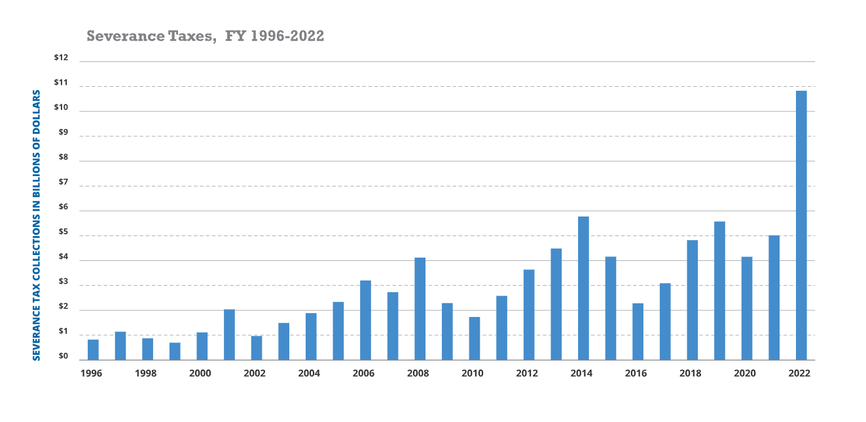
Texas severance tax
Severance taxes make up the most volatile category of tax revenue.
In FY 2022, severance tax collections totaled a record-breaking $10.83b, contributing 14% to the total tax collections.
The amount of these taxes depends on two key factors: the price of the resource and its level of production.
Source: comptroller.texas.gov

Slide 7
Texas severance tax: reporting requirements
Tax type | Natural gas production tax | Crude oil production tax
Taxpayer | Primarily paid by the producer | Primarily paid by the purchaser
Rates | 7.5% of the market value | 4.6% of the market value
Due dates | Reports are due on the 20th day of the second month following the production month | Reports are due on the 25th day of the month following the production month

Slide 8
Texas severance tax: market value
  Gas
  Section 201.101 of the Tax Code states, “The market value of gas is its value at the mouth of the well from which it is produced.” Rule 3.15, Gas Marketing Costs, states, “The ‘market value at the mouth of the well’ shall be determined by ascertaining the producer’s actual marketing costs and subtracting those costs from the producer’s gross cash receipts from the sale of the gas.”
  The purpose of the marketing cost deduction is not to cause the taxable value to be a “net income” tax. It simply equalizes the tax burden for those selling at or near the point of production with those that have to treat the gas and send it further away to market. Where there is no compression, sweetening, dehydration or transportation to the market, there will be no marketing costs.
  Marketing costs may not reduce the taxable value of gas below zero. Marketing costs may not be carried forward from one month to another.
  Oil
  Section 202.053 of the Texas Tax Code states, “The market value of oil is the actual market value plus any bonus, premium, or other thing of value paid for the oil or that the oil will reasonably bring if lawfully produced.”
  Texas does not allow for any oil marketing-related costs to be deducted.

Slide 9
Texas severance tax: marketing costs
Deductions for marketing costs
Marketing costs do not include any costs associated with producing natural gas or with the separation of natural gas from oil, condensate and water.
Includes | Does NOT include
Costs for compressing the gas sold | Costs incurred in producing the gas
Costs for dehydrating the gas sold | Costs incurred in normal lease separation of the oil, gas or condensate
Costs for sweetening the gas | Insurance premiums on the marketing
Costs for delivering the gas to the purchaser
Any process that occurs beyond the mouth of the well that helps bring the gas to market is deductible.
The Texas Comptroller has posted the “Natural Gas Severance Taxes — Audit Policy on Marketing Costs” guide. The Oklahoma Tax Commission has a similar guide, “OAC 710:45 — Appendix A. Marketing Costs.”

Slide 10



Netback calculation: valuation point
Production management
Natural gas treatment and compression
Flow measurement
Low-temp
separator
Gas
Gas
injection
To gathering
Oil
Compression
Scrubber
Water
Fuel gas
To storage
Field video
Gas lift
Condensate
stabilizer
Dehydration and
acid gas removal
Header
Production
separator
Oil and gas production
Vapor recovery
VRU
tower
Gathering and custody transfer
Test separator
Line heater
Water
to disposal
Heater treater
Gun barrel
Chemical injection
Oil treatment and storage
LACT
To pipeline

Slide 11
Texas severance tax: tax reimbursement language
As defined in the Texas Administrative Code Rule §3.18, tax reimbursement is a payment that a purchaser of gas makes to a producer for the purpose of reimbursing the producer for Texas severance taxes that are due under Tax Code, Chapter 201.
Requirements to establish tax reimbursement language (TRL):
  The language must be separately stated in the contract, check stub or purchaser statement.
  The contract between the producer and purchaser must contain language stating that the payment made by the purchaser includes severance tax reimbursement. Merely stating that “all taxes” are included is not specific enough.
  Either party may overcome the presumption by using the purchaser’s records to show that severance tax reimbursement was included in the payment to the producer.

Slide 12

Texas severance tax: tax reimbursement language example
Here is an example:
  As a producer, you sell 1,000 mcf to a purchaser for $3/mcf. The total purchaser price is $3,000.
  For simplification purposes, let’s assume there are no deductions or exemptions in this example.
  As a producer, with no tax reimbursement language, you’d pay taxes on a value of $3,000 — which would be $3,000 * 7.5% = $225 of severance tax.
  If TRL exists in the contract, then the purchaser paid you $3,000 / 1.075 = $2,790.70.
  Now, as the producer, you will pay taxes of $2,790.70 * 7.5% = $209.30.
  This results in $15.70 in savings in this example.

Slide 13
Texas severance tax exemptions
The state of Texas offers various exemptions that reduce severance tax rates for oil and gas.
  Low-producing tax credit: Average production during a consecutive three-month period must be below 15 bbl/day
  (or less than 5% recoverable oil per barrel of produced water) or 90 mcf/day for a well to qualify.
    No exemption: gas price > $3.50, oil price > $30.00
    25% credit: gas price ($3.01–$3.50), oil price ($25.01–$30.00)
    50% credit: gas price ($2.51–$3.00), oil price ($22.01–$25.00)
    100% credit: gas price <=$2.50, oil price <=$22.00
    Crude oil exemption begins falling off to statute on July 20, 2024
Source: comptroller.texas.gov
Pricing schedules and exemption eligibility by month
Report period | Price of gas | Eligibility
July 2024 | $1.19/mcf | Eligible for 100% credit
June 2024 | $1.24/mcf | Eligible for 100% credit
May 2024 | $1.06/mcf | Eligible for 100% credit
April 2024 | $1.10/mcf | Eligible for 100% credit
March 2024 | $1.16/mcf | Eligible for 100% credit
February 2024 | $1.39/mcf | Eligible for 100% credit
January 2024 | $1.56/mcf | Eligible for 100% credit
December 2023 | $1.61/mcf | Eligible for 100% credit
Pricing schedules and exemption eligibility by month
Report period | Price of oil | Eligibility
December 20 | $28.46/bbl | Eligible for 25% credit
November 20 | $28.60/bbl | Eligible for 25% credit
October 20 | $27.68/bbl | Eligible for 25% credit
September 23 | $26.13/bbl | Eligible for 25% credit
August 20 | $22.24/bbl | Eligible for 50% credit
July 20 | $17.86/bbl | Eligible for 100% credit
June 20 | $17.62/bbl | Eligible for 100% credit
May 20 | $24.27/bbl | Eligible for 50% credit

Slide 14
Texas severance tax exemptions
High-cost gas: The HCG exemption offers a partial to full exemption depending on total drilling and completion costs and TCO median costs for the fiscal year.
  Produced from a depth at or deeper than 15,000 feet
  Produced from Devonian shale
  Produced from designated tight formations
  Produced under other conditions deemed risky or costly by the Federal Energy Regulatory Commission
  Reduce tax rate: first production — 10 years or when payout is reached (whichever comes first)
Steps to qualify for HCG exemption:
  File Form ST-1 with the Railroad Commission of Texas
  File Form AP-180 with the Texas Comptroller
  File all prior-period adjustments with the Texas Comptroller
When an oil or gas well qualifies for multiple severance tax incentives, a taxpayer can choose which incentive is most favorable.

Slide 15
Oklahoma Gross Production Tax: oil and gas
Imposition
  The Oklahoma gross production tax is imposed upon the production of oil and gas. Okla. Stat. Ann. tit. 68, §1001(B)(1) and (2)
    “Oil” is defined as petroleum or other crude or mineral oil. Okla. Stat. Ann. tit. 68, §1001.2(c)
    “Gas” is defined as natural gas or casinghead gas. Okla. Stat. Ann. tit. 68, §1001.2(a)
Basis
  In Oklahoma, the gross production tax is levied upon the gross value of the production of the resource extracted and attached to and is levied on royalty interest. Okla. Stat. Ann. tit. 68, §1001

Slide 16
Oklahoma severance tax and legislation
Severance tax revenue is more volatile than other revenue sources due to fluctuations in the oil and gas sector.
In fiscal 2023 $1.8 billion was collected in gross production severance taxes, accounting for nearly 13% of total tax revenues in Oklahoma.
House Bill 2763 (2016) created the Revenue Stabilization Fund to reserve tax collections from volatile revenue sources when they are projected to be above the preceding five-year average.
House Bill 3568 (2022) provided a full severance tax rate exemption for certain secondary and tertiary recovery projects for five years from the start date.
Source: Oklahoma Tax Commission. (2023). FY 2023 Revenue & Apportionment Report. Retrieved from Oklahoma Tax Commission website.

Slide 17
Oklahoma severance tax: marketing cost deductions
Marketing cost deductions
  Producers of natural gas and casinghead gas who incur marketing costs for the gas produced may deduct these costs from the gross value when computing the gross value subject to gross production tax and petroleum excise tax. Okla. Stat. 68 §1002; Okla. Stat. 68 §1001.4(A); Okla. Admin. Code 710:45-9-100.
  Any process that occurs beyond the mouth of the well that helps bring the gas to market is deductible.
Marketing costs include | Marketing costs DO NOT include
Costs for compressing the gas sold | Costs incurred in producing the gas
Costs for dehydrating the gas sold | Costs incurred in normal lease separation of the oil, gas or condensate
Costs for sweetening the gas | Insurance premiums on the marketing
Costs for delivering the gas to the purchaser

Slide 18
EY | Building a better working world
EY exists to build a better working world, helping create long-term value for clients, people and society and build trust in the capital markets.
Enabled by data and technology, diverse EY teams in over 150 countries provide trust through assurance and help clients grow, transform and operate.
Working across assurance, consulting, law, strategy, tax and transactions, EY teams ask better questions to find new answers for the complex issues facing our world today.
EY refers to the global organization, and may refer to one or more, of the member firms of Ernst & Young Global Limited, each of which is a separate legal entity. Ernst & Young Global Limited, a UK company limited by guarantee, does not provide services to clients. Information about how EY collects and uses personal data and a description of the rights individuals have under data protection legislation are available via ey.com/privacy. EY member firms do not practice law where prohibited by local laws. For more information about our organization, please visit ey.com.
Ernst & Young LLP is a client-serving member firm of Ernst & Young Global Limited operating in the US.
© 2024 Ernst & Young LLP.
All Rights Reserved.
SCORE no. 24847-241US
2410-10407-CS
ED None
This material has been prepared for general informational purposes only and is not intended to be relied upon as accounting, tax, legal or other professional advice. Please refer to your advisors for specific advice.
ey.com

