Slide 1
Getting to the Bottom of Higher Gasoline Prices
Presented to San Antonio Council of Petroleum Accountant Societies
Jeffrey G. Nichols, Vice President
Stancil & Co.
January 24, 2023

Slide 2
What is Driving Our Gasoline Prices?
Why do prices seem to change so much over a year or two?
Why do prices seem so different across the US at a given time?
How much of the price is production costs and what else is included in the pump price?
Hopefully, this presentation will provide you with some answers and a better understanding of gasoline prices.
Let’s start with some basic information on gasoline …..

Slide 3
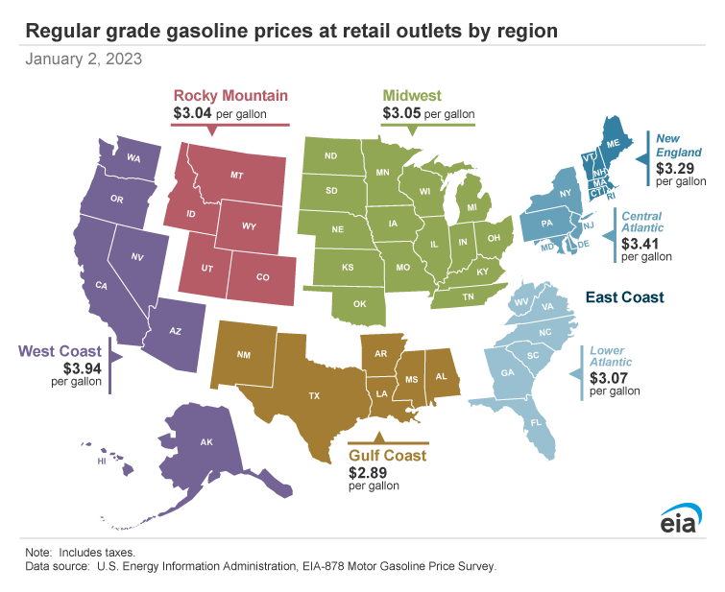
Gasoline Pump Prices do Vary Considerably Across the US

Slide 4
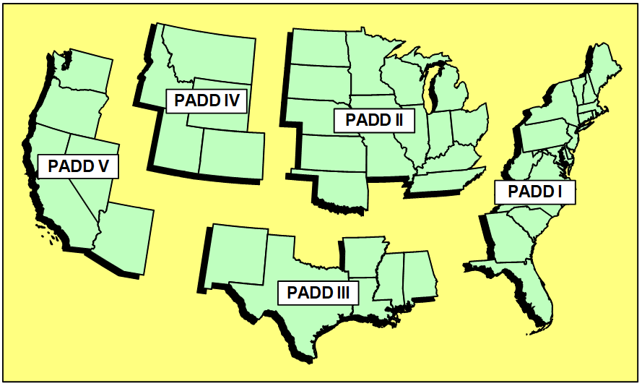
EIA PADD Regions

Slide 5
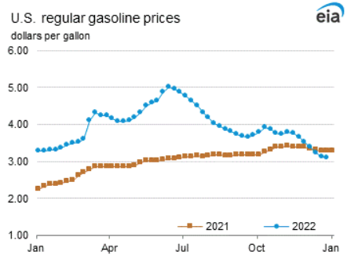
Gasoline Pump Prices - Have Varied from $2 to $5 per Gallon in the Last 2 Years

Slide 6
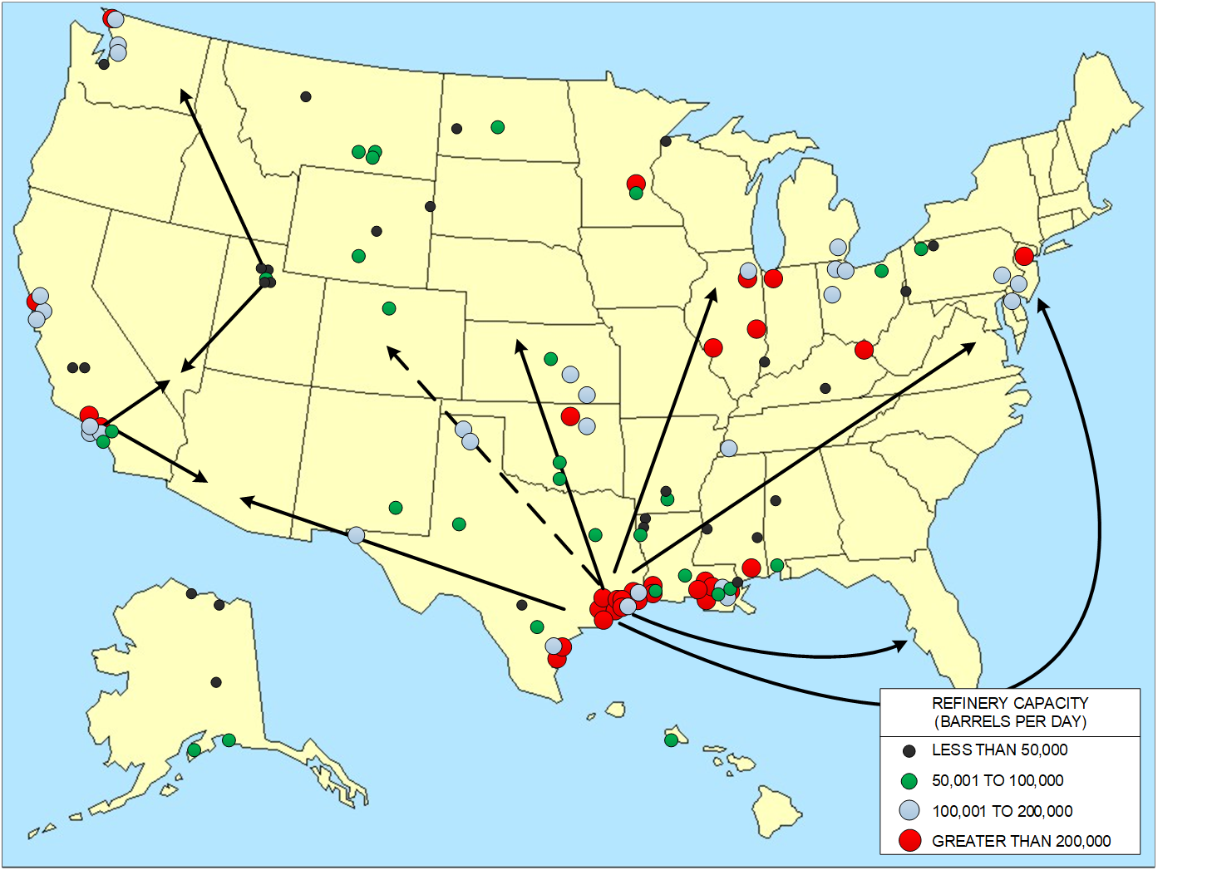
Gasoline is Produced in Refining Centers and Transported by Truck/Barge/Pipeline to Markets
Refinery Locations and Supply by Corridor
Approximately 111 Operating US Refineries as of January 2022
Total Crude Capacity is 17.5 million barrels per day
Average Capacity is 158,000 barrels per day
15 Refineries have capacity above 300,000 barrels per day and represent 37% of total capacity

Slide 7
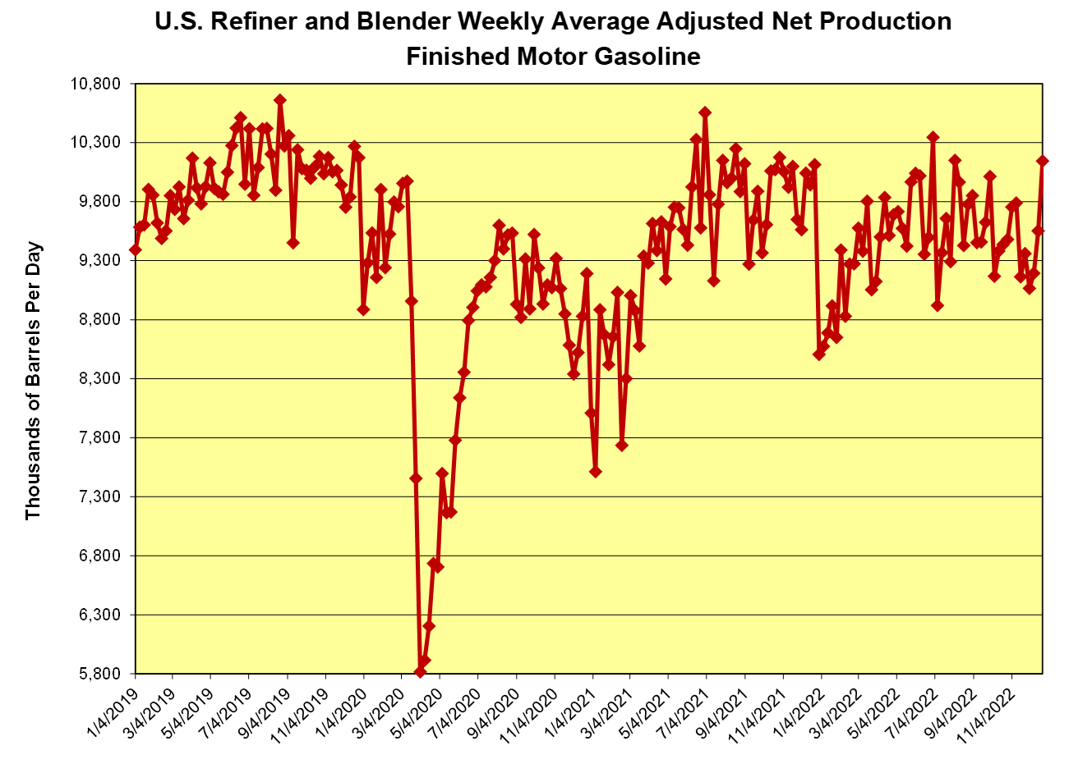
Gasoline Demand has Returned
Demand has returned to 2019 levels.
Production often exceeding 10 million barrels per day in 2022.

Slide 8
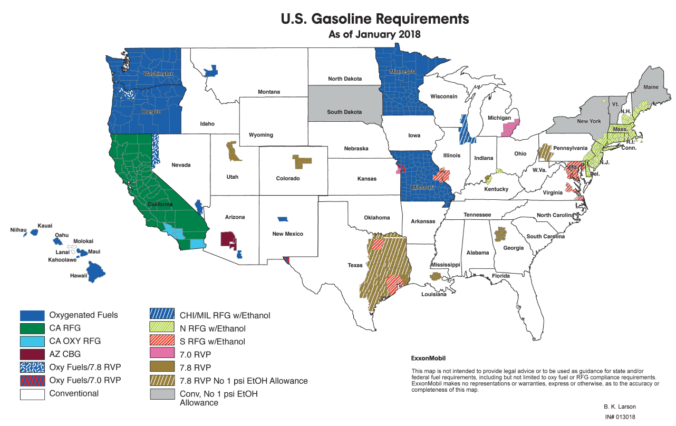
Some Areas Require Special Summer Gasoline Formulations to Reduce Air Pollution
Federal “Reformulated Gasoline (RFG)” and “State Implementation Plan (SIP)” – typically lower vapor pressure in high population or high pollution areas.
California regulations control other gasoline properties and are in affect all year.

Slide 9
With that as an overview lets move on to factors affecting Gasoline Cost

Slide 10
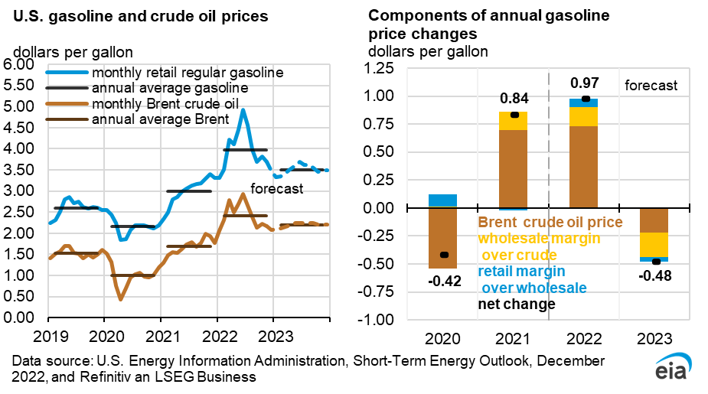
Crude – Typically 50% to 65% of Pump Price
When prices change by large amounts across the whole US, it is usually due to crude oil price changes in the World market as shown below:

Slide 11
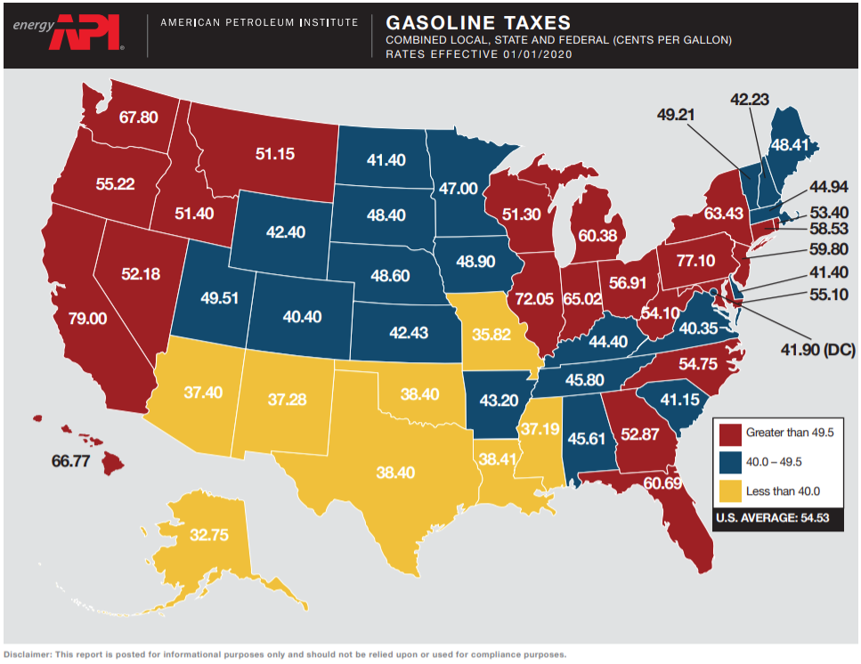
Taxes – Varies from 32 to 86 Cents per Gallon
When prices change as you drive across the US a big part of that difference is State fuel taxes. Federal tax on gasoline is 18.4 cents per gallon.

Slide 12
Refinery Cash OPEX and Logistics Costs
Refinery manufacturing costs vary by refinery size, complexity and location.
Transportation costs vary by type and delivery distance.
These costs can be 16 to 55 cpg of the pump price.

Slide 13
Refinery G&A and Sustaining CAPEX Costs
Refinery General and Administrative Costs reflect costs of back office, legal, company management and marketing.
Usually between $0.70 - $1.25 per barrel of crude processed
Long-Term Sustaining CAPEX is usually around 2% of replacement cost for refineries.
Usually between $1.65 - $2.50 per barrel of crude processed
These costs can add 6 to 9 cpg to the pump price.

Slide 14
Renewable Fuels Program Costs
Federal program requires biofuel blending by producers of gasoline and diesel. Renewable Identification Numbers (RINs) are credits traded between entities for compliance. These RIN costs have risen substantially since 2019 and now represent almost 20-25 cpg of the pump price.

Slide 15
California Gasoline – Additional Costs
Green House Gas Program (GHG)
Fuel Suppliers are required to purchase carbon allowances to partially offset the GHG emissions from combustion of the fuel.
Cost is ultimately passed on to the consumer through a charge referred to as “Cap-at-the-Rack”.
Current price of allowances is approximately 27 cpg
Low Carbon Fuels Program (LCFS)
Program requires a reduction in the carbon intensity (CI) of transportation fuels with a target of 20% reduction by 2030.
Fuel producers and importers comply with the program by either blending lower CI biofuels or purchasing credits from other blenders or credit generators.
The obligation to purchase credits can be passed on to each entity in the supply chain….ultimately to the consumer.
Average value for LCFS credits in 2022 is approximately 20 cpg.

Slide 16

Illustrative Example – San Antonio, Salt Lake City, Los Angeles

Slide 18
Questions??
  Jeffrey G. Nichols
  Vice President
  Stancil & Co.
  400 E. Las Colinas Boulevard
  Suite 700
  Irving, Texas 75039
  Office: 214-688-0255
  Cell: 817-845-9270
  www.stancilco.com

