Slide 1

Crypto Mining Using Natural Gas
Matthew Milligan, CPA, APA

Slide 2
Blockchain and Cryptocurrency
A Blockchain is a permanent and secure digital record of cryptocurrency transactions. The transactions are recorded chronologically and are available to be viewed publicly. The blockchain, as its name suggests, comprised of a linkage of blocks, where each block is simply a batch of completed transactions.
Cryptocurrency is a digital currency in which transactions are verified and records maintained by a decentralized system using cryptography, rather than by a centralized authority.

Slide 3
Hash Difficulty, Block Rewards, Halving
Hash rate, also known as hash power, is a measure of a miner’s performance. It is defined as the rate at which a computer can create output hashes from a given input. In other words, it is the number of random guesses that a computing unit can make within a particular timeframe..
A halving in crypto is an automated process within some blockchains (especially those based on the Bitcoin network) in which the reward for mining new blocks to the chain is reduced. Therefore, halving consists in reducing the block reward gained by miners and thus controlling the pace of creation of new cryptocurrencies. May 2024 next BTC halving event expected.
Hash Difficulty - Simply explained, it’s just the complexity of the task that miners need to solve to create the block (the problematic piece of the puzzle to find). This difficulty could change. It depends on the hash rate of the network (the number of miners who mine off this coin). If there are not many miners, difficulty falls, if there are a lot of miners, the difficulty starts growing, and it becomes harder for a particular miner to find this block.
A block reward is defined as the amount of cryptocurrency distributed to miners by the network for creating a block and successfully adding it to the blockchain. Block rewards are viewed as incentives to attract miners while acting as a controlled mechanism for releasing coins or tokens into the circulating supply.

Slide 4
Crypto Pooling and Wallets
Cryptocurrency mining pools are groups of miners who share their computational resources. Mining pools utilize these combined resources to strengthen the probability of finding a block or otherwise successfully mining for cryptocurrency. If the mining pool is successful and receives a reward, that reward is divided among participants in the pool.
A crypto wallet can also be termed a blockchain wallet. For better understanding, a crypto wallet is like a bank account, a private key is the bank account’s password or the access key, the public address is the bank account number, the blockchain is the bank’s ledger, and the custodian is the banker (in case of custodial wallets).

Slide 5
What is crypto mining?
Crypto mining is using extremely high powered mining servers, or rigs, to create individual blocks that are added to a blockchain by solving complex mathematical problems. The purpose of mining is to verify cryptocurrency transactions and show proof of work which acts as a ledger for mining transactions. As an incentive, miners receive a reward in cryptocurrency for each block added to the chain. This reward is how new coins are generated and put into circulation. Crypto mining involves several proof systems depending on the type of cryptocurrency. Since the blockchain is decentralized, mining is uniquely different from central banks and the creation of fiat.

Slide 6
How to mine for crypto currency/tokens using natural gas?
First things first, obtain clear lease and surface use agreement that identifies the crypto mining activities explicitly. Further, the agreements need to be clear that the royalty owners will only be entitled to the royalty generated from their minerals, at market price, and will not participate in any of the crypto operations. An annual surface use agreement payments are advised as well.
Construct a mining rig that aggregates miners into a server farm held within a container. Configurations of your mine exist to allow for better energy usage and for “overclocking” the miners.
The number of miners depends on the gas well production level and the corresponding kWh generated from the production. Further, it depends on which mining equipment you use and the capacity of the generator you use. Mines will vary, well by well, based upon these various factors.
The conversion is 293.083 kWh per mcf.
In South Texas, this usually involves immersion cooling equipment to combat the high heat and high costs associated with cooling via other methods.
Security and insurance is also advised as mining equipment is very expensive and easily transported.

Slide 7
Other Oil & Gas Considerations
Clear methodology for determining market rate with the royalty owners.
Severance taxes are due on what was produced, as normal.
Energy Efficiencies – Operating costs via natural gas mining = $0.02/kWh vs. Retail energy costs at $0.08 – $0.10/kWh
Opportunities to generate value from gas wells far from gathering lines and marginal wells that don’t warrant the construction of a pipeline.
Geography and location of tech/service providers.

Slide 8
Proof of Work vs. Proof of Stake
Proof of Work - Proof of work (PoW) is a form of cryptographic proof in which one party (the prover) proves to others (the verifiers) that a certain amount of a specific computational effort has been expended. Verifiers can subsequently confirm this expenditure with minimal effort on their part.
This is crypto mining.
Proof of Stake - Proof of stake (PoS) protocols are a class of consensus mechanisms for blockchains that work by selecting validators in proportion to their quantity of holdings in the associated cryptocurrency. This is done to avoid the computational cost of proof of work schemes.
This is holding your coins on the ledger and being compensated based on the time and amount of coins held on the ledger.

Slide 9
Tax Treatment re: POW vs. POS
Proof of Work (PoW) – The costs for building the mine are capitalized and depreciated over a five year life. Operating expenses offset the value of the mined crypto currency, generating operating income. If sold for fiat at time of mining, normal operating income tax is determined.
If coins are held, the operating income tax is still incurred as noted above, but now you have a “basis” in the held coins/tokens. Upon disposal, capital gain/loss tax treatment will be incurred using this basis.
Proof of Stake (PoS) – As these coins are “gifted” to those that hold them within their wallet, the coins/tokens generated via PoS have zero basis. As of now, there is no tax incurred upon the receipt of the coins/tokens via PoS. Upon disposal of PoS coins, the seller will incur capital gain/loss tax treatment the the coins/tokens will have a zero basis.

Slide 10
Short List of Crypto Coins and Tokens
Bitcoin (BTC) - a type of digital currency in which a record of transactions is maintained and new units of currency are generated by the computational solution of mathematical problems, and which operates independently of a central bank. BTC will be limited to only 21 million BTC.
Etherium (Eth) - Ethereum is a decentralized, open-source blockchain with smart contract functionality. Ether is the native cryptocurrency of the platform. Among cryptocurrencies, Ether is second only to Bitcoin in market capitalization.
Litecoin (LTC) - Litecoin is a peer-to-peer cryptocurrency and open-source software project released under the MIT/X11 license. Litecoin was an early bitcoin spinoff or altcoin, starting in October 2011. In technical details, Litecoin is nearly identical to Bitcoin.
Dogecoin (DOGE) - Dogecoin is a peer-to-peer, open-source cryptocurrency. It is considered an altcoin and an almost sarcastic meme coin. While it was created seemingly as a joke, its blockchain still has merit.
Shiba coin (SHIBUSD) - Shiba Inu is an Etherium-based altcoin that features the Shiba Inu—a Japanese breed of hunting dog—as its mascot. Shiba Inu is widely considered to be an alternative to Dogecoin.

Slide 11
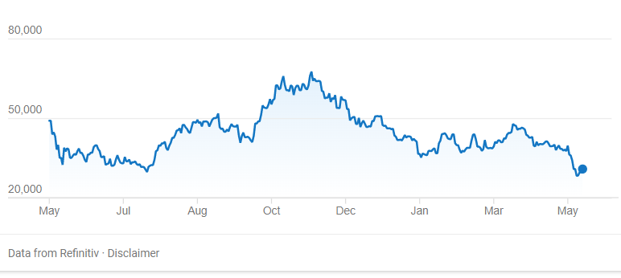
Bitcoin Price Chart – 1 Year
Price on 5/16/2022 = $29,500/BTC
All-Time High = $68,789/BTC

Slide 12
Current Environment
UST/Terra Coin/Luna Coin Default – Lost 99.7% of value over a weekend.
Coinbase hinting at user wallets being included as assets if bankruptcy were to occur.
Michael Saylor and Microstrategy holdings and the $21,000/BTC potential margin call.
Prior year highs ($68k+/BTC) incentivized a large increase in crypto miners and a corresponding increase in hash difficulty (18.3T hash diff. rate in 9/2021 vs. 26.6T hash diff. rate in 3/2022). This has reduced the block reward dramatically.
Supply chain issues re: miner/equipment acquisitions coupled with rising energy/material costs.
Demand for service providers.
Potential Regulation
Potential Fed-Backed crypto currency (i.e. China’s blockchain system and ban of BTC).
Potential as a battery or back-up for the grid – limited possibility as most will be off-grid and not party to a gas marketing contract.

