Slide 1

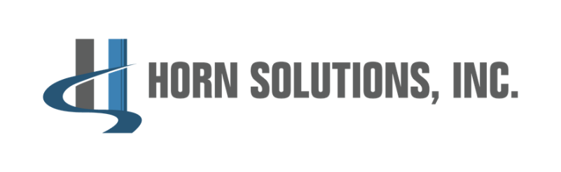
Employment Markets Today
COPAS MARCH Meeting
Notes:
From far east FW
Grew up in Plano, TX after attending the Marrriott school at BYU I spent 2 years abroad in Venezuela on a church mission, then came back to Dallas.
Public and private companies over the last 17 years in professional services
Those stints we in the Southern US mostly based in TX
Reside in Houston but spend most of my time in the Dallas market
Business in FW

Slide 2
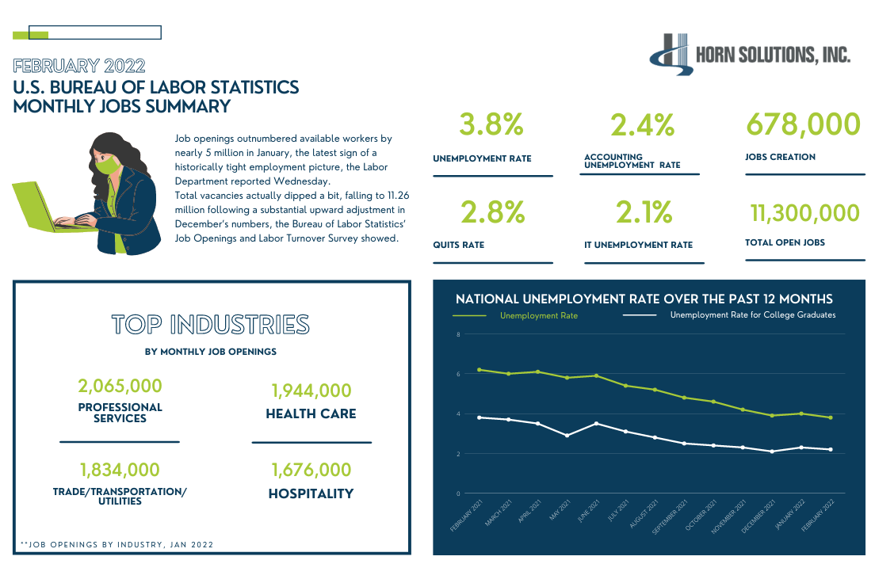
Notes:
2021 and 2022 will be a case study for our children and economists for years to come.
JOLTS report
Disappointing Nov/Dec jobs growth was revised up and January job growth was nearly triple expectations.
Dwindling workforce—Labor participation rate: 62.2% (climbing but historically you have to go back to May 1977 to find similar data.
In August of 2021 the workforce was 5 million people shortly of what it was pre-pandemic. The workforce has expanded today to be about 2 million people light of pre-pandeminc levels.
Where are people going?
Shecession
Retirement (semi-retirement)
Family planning (support/care)
Other interests—small business and side hustle

Slide 3

Small business Boom
Notes:
Applications to start new companies in 2021 were up 53% from pre pandemic levels in 2019.
There were 430,000 applications in January from data released this past week
The 2010s were widely descrived as the lease entrepreneurial decade in US history

Slide 4
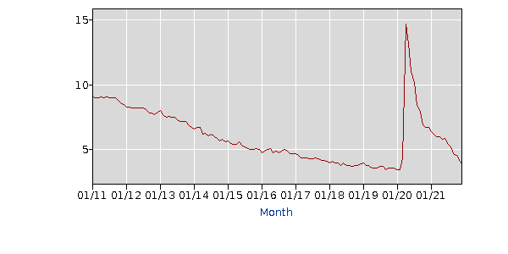
Unemployment Historical rates
2021 Unemployment fell from 6.4% in January to 3.9% in December.
During the last recovery, the economy took 48 months to close the exact same gap.
Notes:
Unprecedented time in employment markets

Slide 5
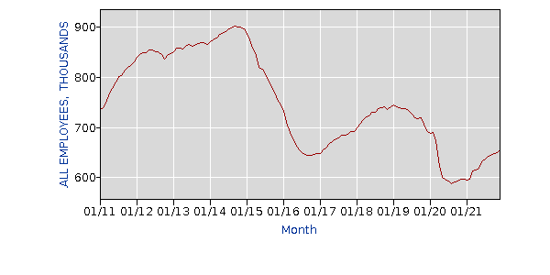
Natural resources and mining workforce
Notes:
Over the last decade jobs peaked in late 2014 around 900k positions. Today there are about 650k.

Slide 6
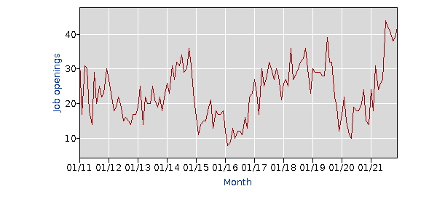
Job openings—is this an EKG?

Slide 7
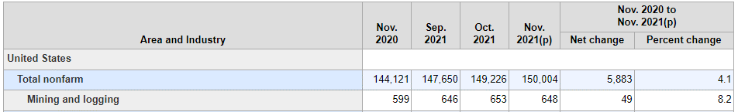
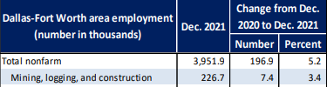



Oil and Gas employment
Notes:
--review trends in the statistics.
What are the implications:
Some are getting sick of the inconsistency in the oil/gas markets
Others have been forced to pursue interest and other industries
Oil/gas is consistently misunderstood by the younger generation—media and political figures continue to drive most of the disdain that exists
Long term is mean that the number of people in the workforce naturally pursuing oil/gas opportunities will continue to dwindle

Slide 8

Remote, Hybrid or Return to office
Notes:
Executives and employees disconnect
Widely misunderstood dynamics
WHY?
People feel taken advantage of
Individuals are reprioritizing life
Experiences during the pandemic shifted everything
Example—my workouts
Walking the dog
Clothing choices

Slide 9
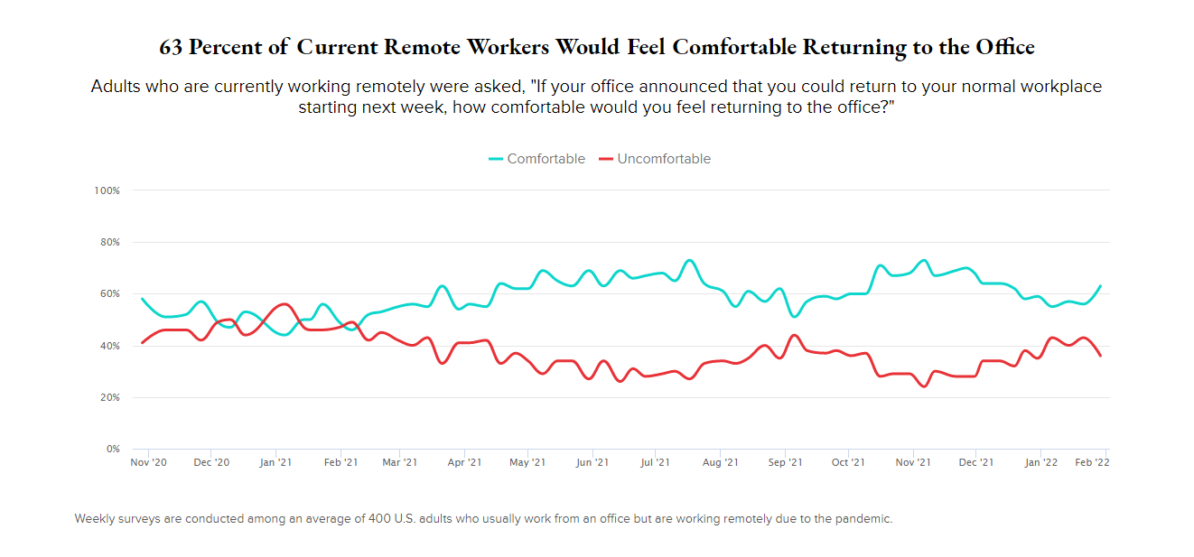
Notes:
This data is a little misleading….
Admit it, COVID has become and excuse for everything—in todays culture you can be cancelled for even discussing it.
Dentist example
Panera with the family
RT dinging out, traveling, going to school, to church but not RTO

Slide 10
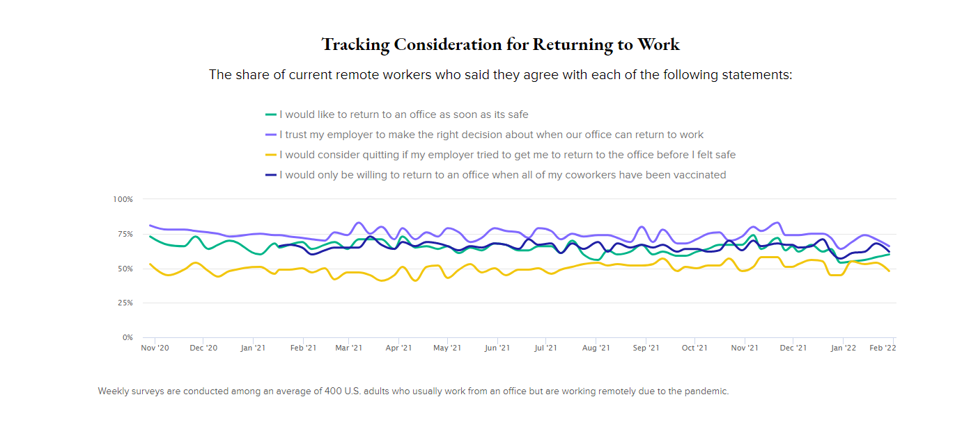
Notes:
How does an executive read this data vs and employee?
Executives: the majority of employees want to be back in the office full time.
Employees: I would like to have access to the office when needed.

Slide 11
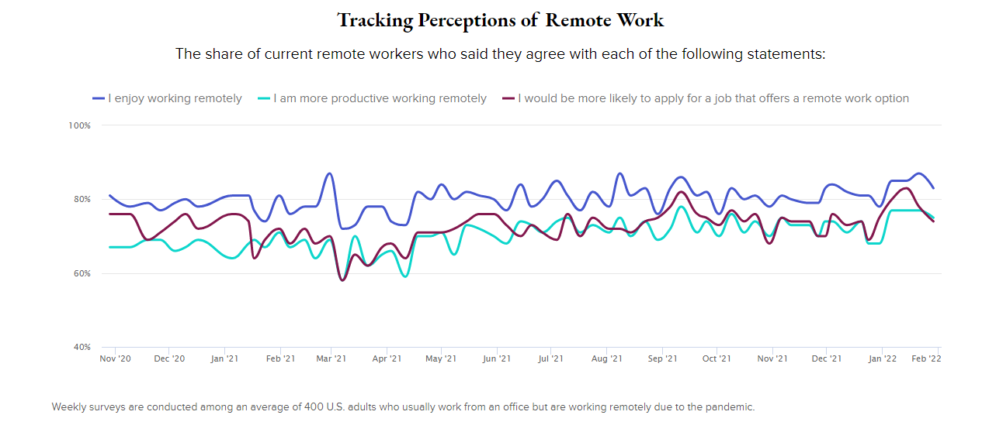
Notes:
So what does the average employee want:
Options: employers that were never a consideration are now in the mix (remote work)—this creates compensation dynamics as well.
Remote or hybrid: most people want the option to work remote or split home and office time--
Flexibility—this is a big factor and cannot be overlooked a part of they way life have evolved over the last 24 moths especially
TX vs the coasts: experience in TX vs the “coasts”
Fresh opportunity
Growth

Slide 12
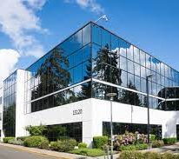


Why is remote work getting push back?
Notes:
Boils down to 3 reasons why RTO is such a hot topic for executives and managers

Slide 13
Company policy and SCOTUS

Slide 14
Disconnect with policies
Vaccinations and the intentions
State of TX laws
SCOTUS ruling
Options
Notes:
Vaccinations and testing: what do we now know about the 2
TX: Texas state laws want Texans to decide for themselves vs federal government mandates. This has created challenges for some employers who have corporate or executive teams in other states. For example. ORIX
Impact of the SCOTUS rule (starbucks, NIKE, etc)

Slide 15
Recruiting best practices
Move FAST
01
Know what you are looking for
02
Screen in vs. screen out
03
Make an aggressive offer
04
Stay organized
05
Notes:
Move Fast: showcase organization and prioritization of this candidate and their role—many use this experience as a metaphor for the type of company you are and will be for them as an employee,
Know what you are looking for: be flexible but committed to the skill sets and type of employee you desire. Many enter the job search unsure of the type of person they will hire and this create ambiguity
Screen in: You are evaluating the candidate, but look for reasons someone is a fit vs not a fit. You don’t have to want them but these should always want you.
Make an aggressive offer—put you best foot forward and showcase through your compensation that you want them!
Stay organized: set aside the time and commitment as a major priority and don’t allow other things to get in the way. Don’t cancel and heaven forbit, don’t know-show a meeting

Slide 16
Job Search—future or now?
3 out of 4 full-time employees are planning to quit their job in the next 12 months. 79% of employed job seekers believe they can make more money by switching jobs than staying put in the current market.
Benefits are playing a bigger role: 67% of job seekers say that benefits are more important now than before the pandemic, and 54% would consider taking a lower-paying job with a better benefits package
37% of job seekers believe it will be easier to find a job this year than in 2021
Notes:
Data suggests that 75% of all employees are considering leaving their job in the next 12 months. Many believe they will make more money by switching jobs than staying put in the current market
It’s not just a compensation game…67% of job seeker say that benefits are more important now than before the pandemic.
Job seeker optimism is higher than it has ever been

Slide 17
Role of Professional Services in today’s economy
Not just a luxury to have contract staff anymore
Knowledge transfer (institutional knowledge retention)
Project or consulting support
Full time hire attraction (not a post and pray environment)

Slide 18
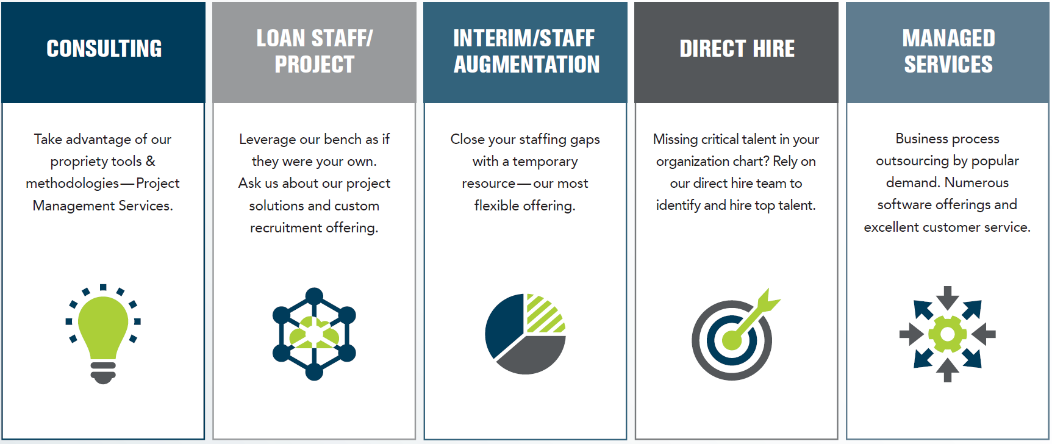
Horn solutions practice areas
Finance
Accounting
Tax
Audit
Technology
Data
CPQ
Project Management
UX/UI
Notes:
How do PS firms like Horn Solutions play a role in this marke

Slide 19

Questions

