Slide 1

Vendor Auditing Program
Implementing Best Practices
PASSA Audit Committee
March 2022
Kim Goodwin
AMS-PAR Audit Manager

Slide 2
Outline
The need for vendor auditing……………………………. 3
Risk Analysis…..…………………………………..……… 4
Planning and Fieldwork………………………………….. 5
Auditing Technology………………………………………. 6
Typical Findings…………………………………………… 7
Applying Lessons Learned………………………….…… 9
The Value of Supplier Reviews………………………….. 10

Slide 3
Learning Objectives
By the end of this session, we hope you will be better equipped to…
understand how to identify higher risk vendors based on several variables;
identify various motivations behind an effective vendor audit programs;
understand the most common audit findings for vendor audits;
gain an understanding of common hurdles and pitfalls of building a vendor audit program;
how to implement lessons learned from vendor audits.

Slide 4
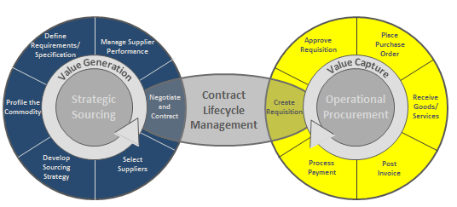
Contract Compliance
The Challenge
True cost savings are best realized when all stakeholders take an active role in contract compliance. As organizations drift from this priority it can result in negotiated savings never being implemented or captured. With millions of dollars in savings at stake, proactive contract compliance monitoring is paramount.*
Geographically dispersed workforce
Complicated contracts with many moving parts
Vendors doing work for multiple offices and business units
Hundreds of invoice approvers
Corporate and “field” procurement professionals
Industry estimates are that 30% to 70% of negotiated savings are lost due to poor contract management and non-compliance

Slide 5
Risk Analysis
Determining your contract compliance
Determining which vendors to audit?
Risk profile matrix can include…
Total Spend
Have they been audited before?
Total Spend
Have they been audited before?
Category
Operations Interviews
Vendor Spend
Have they been audited before?
Category
Operations Interviews
Contract Due Diligence Review (type, rates, complexity, etc.)
Review of recent invoice
Determining what the “audit” looks like? What is the desired outcome?
A vendor audit can be…
Review of most recent invoice(s)
Review of most recent invoice(s)
On-site review/price verification for last 3 years of billings
Insurance verification
On-site, complete contract compliance review for last 3 years of billings
Insurance verification
Business Relationship Testing / Conflict of Interest

Slide 6
Audit Planning/Fieldwork
Executing your auditing program
Planning
  Notify vendor
  Data request and schedule on-site
  Obtain data and build audit plan before you go on-site
  Review audit plan with lead auditor
Effective and efficient planning can save thousands of dollars and weeks of time.
Fieldwork
  Day 1 kick-off meeting
  Work with vendor to confirm/remove issues
  Build work papers and document findings
  Review findings with vendor before completion

Slide 7
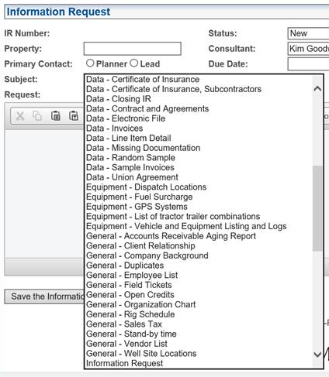
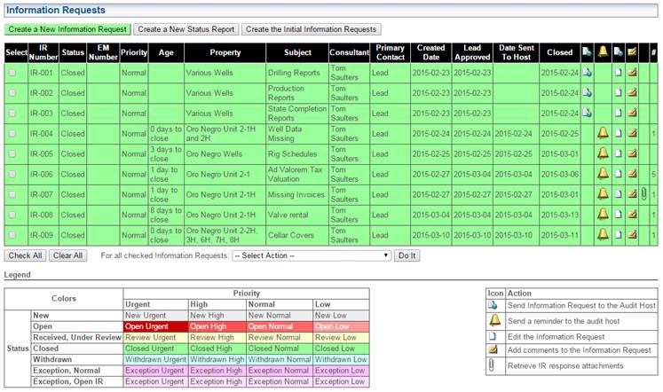
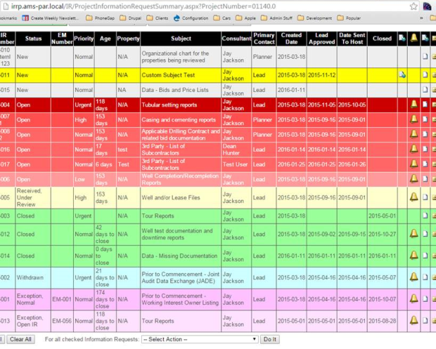
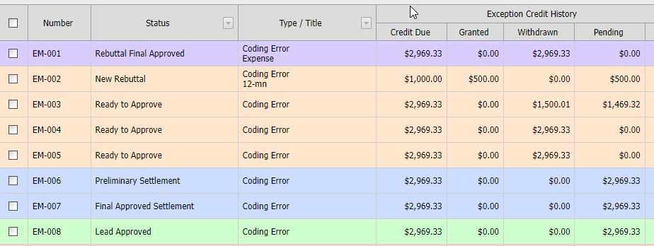
Auditing Technology
Audit efficiency and organizational tools
The right technology for your organization will 1) keep your company organized, 2) reduce the amount of “non-audit” time, and 3) provide the right reports for your needs.
  IR / EM dropdown menus
  IR / EM log and status details
  Rebuttal tracking

Slide 8
TYPICAL FINDINGS
Drilling
Services and Equipment
Crew minimums not met or use of under-qualified crew
Inaccurate calculation and categorization of mobilization, down-time, demobilization periods, rig-up, and rig-down time/repair time.
Excess repair time billed per rig
Charging of unearned safety, performance, or completion bonuses
Verbal agreements overriding contract provisions
Quantities billed and support detail variances
General billing errors
    Rates (billing wrong equipment)
    Double billing of equipment
Billing equipment expected to be included in overhead
Billing idle equipment (e.g., inclement weather, travel, etc.)
Equipment on invoice not supported by field tickets
Rental equipment credits received by contractor were not credited back to client
Use of incorrect or unapproved price books
Trucking and Transportation
Duplicate frac tank rentals (one tank being charged at two locations on same day)
Clerical errors on field tickets or invoices
Un-allowed markups on third party services such as disposals & wash-outs
Drivers working more than the allowable FMCSA hours
Inaccurate barrel quantities billed
Driving hours, trip distances not consistent with workload
7

Slide 9
TYPICAL FINDINGS cont.
Labor
Oilfield consultants billing inaccurate mileage/ per diem
Improper billing of overtime, vacation time, and per diem
Direct billings in areas covered by overhead mark-up
    Training time
    Office management time
    Maintenance time on company owned equipment
Non-reimbursable adders (cell phones, business meals, Sr. Leadership time, etc.)
General billing errors
    Spreadsheet/input errors due to manual billing practice
    Labor billings do not match timesheets / classifications
Tracking your findings by spend category, vendor, finding type will allow you to increase your risk analysis on the front-end audit planning process
Material
Incorrect calculation of discounts or volume rebates
Incorrect margin calculations or pricing
Implementation of price increase prior to effective date of change
Tubulars not inventoried or credited
Direct billing of small tools/consumables intended to be covered in established adder
System limitations adversely impacting SCM initiatives
    Pricing of inventory items basis FIFO method
    ERS implementation resulting in misapplication of cash
    Material receipt data entry errors
8

Slide 10
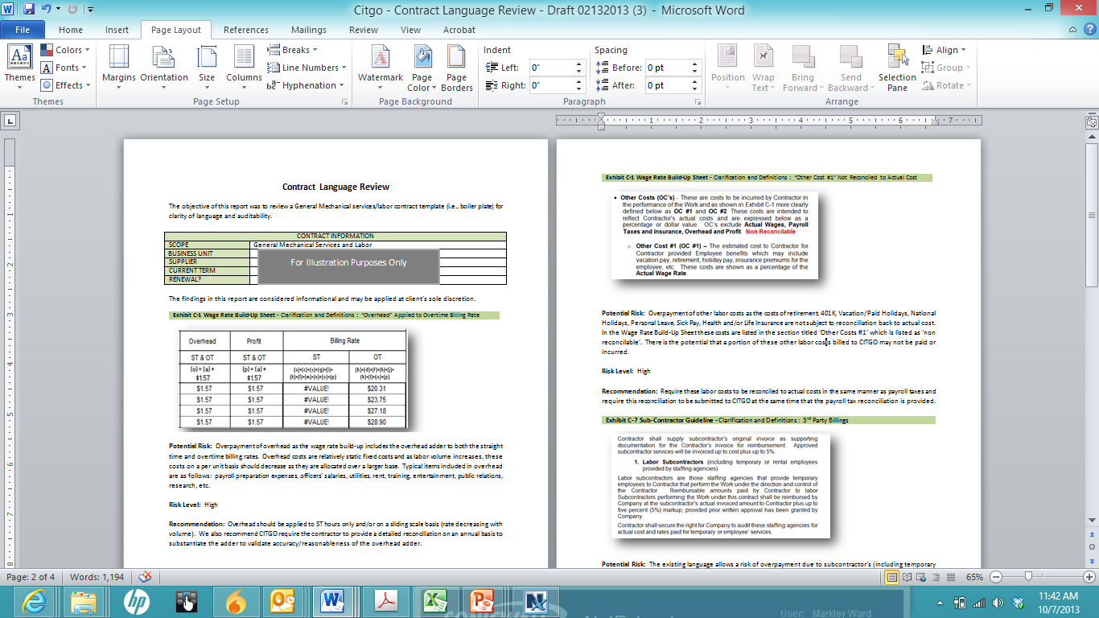
Audit Lessons Learned
Using audit findings to enhance company standards
Vendor audits identify gaps in processes and organizations which allow contract leakage. They do not fill or remove gaps. Audit can work with procurement, operations and the vendor to implement best practices and remove gaps.
Potential Outputs from Vendor Audits
  Contract language review
  Contract Amendments
  Management action plans
  Real-time invoice review implementation
  Enterprise lessons learned implementation
  Pre-engagement kick-off meeting / Vendor onboarding program
  Process improvements
Identify contracts risks

Slide 11

The Value of Supplier Reviews
Supplier contract compliance reviews serve as an invaluable tool for a client’s business. By conducting them regularly, the greater insight you will have into which suppliers should be chosen for review of their invoicing, operations, labor, and transportation costs and practices. Conducting an efficient evaluation and selection process before the audit begins will provide the possibility of better monetary returns for the company, as well as possible contractual improvements, help eliminate unnecessary expenses, and bolster the performance of the suppliers picked for review. These benefits cannot be overstated.

Slide 12

Questions and Comments

