Slide 1
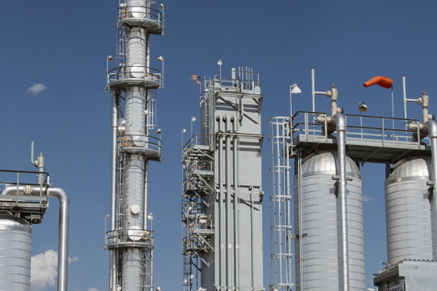
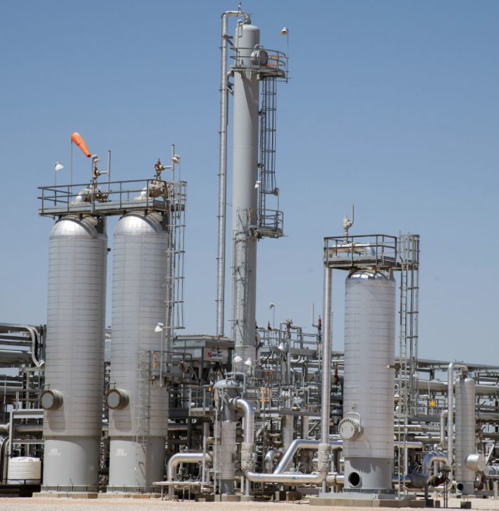
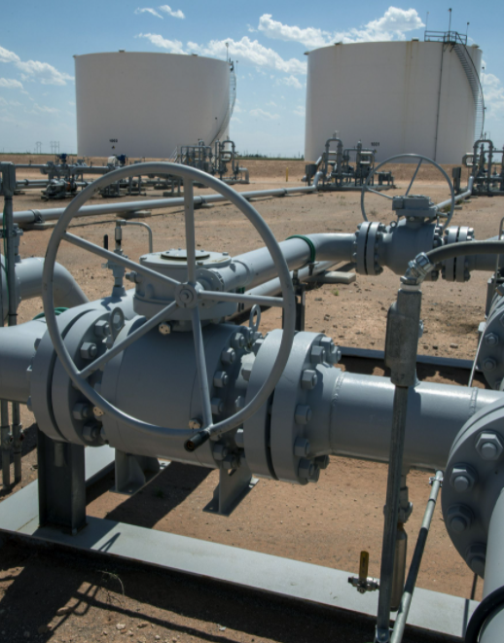

Midstream Accounting - Pursuing the Future
Instructor:
Dan Hodgson, CPA, APA®

Slide 2
Objectives
Identify the Basics of Midstream Processing and Accounting
Discuss Pursuing the Future of Midstream Accounting
Ways to Grow with COPAS – Council of Petroleum Accountants Societies

Slide 3
Instructor Bio
Dan Hodgson
BBA Accounting – University of Houston
MS Accountancy – University of Houston Clear Lake
Texas - Certified Public Accountant
COPAS – Accredited Petroleum Accountant
COPAS – Current Chair of the Midstream/Downstream Sub-Committee
COPAS – Currently Vice-Chair of the Board of Examiners for the
Accredited Petroleum Accountant Program
35+ Year Experience with Oil and Gas Midstream Accounting

Slide 4
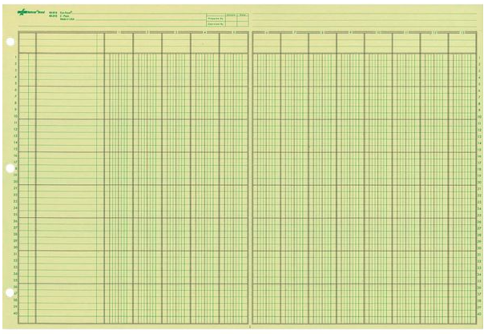
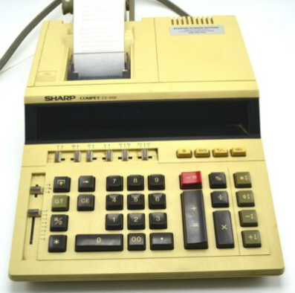


My First Gas Plant Accounting Software
Delete Key

Slide 5
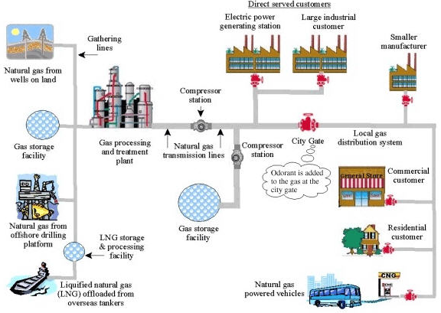
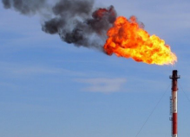
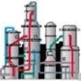


Midstream Gas Processing and NGL Transportation and Fractionation
Midstream
Processing, Transportation, Storage and Disposal
NGL transmission lines
Petro-Chemical
Fractionator
Residential and Farming
Refinery Blending
Modified from U.S. Department of Transportation

Slide 6
COPAS Committees
Standing Committees
Audit Committee
Education Committee
Financial Reporting
Joint Interest Committee
Revenue Committee
Small Oil and Gas Companies Committee
Subcommittees
Emerging Issues Subcommittee (Audit)
Vehicle Rates Subcommittee (Joint Interest)
Employee Benefits Subcommittee (Joint Interest)
Materials Subcommittee (Joint Interest)
Bureau of Land Management Subcommittee (Revenue)
Fed Regulatory Affairs Subcommittee (Revenue)
Midstream / Downstream Committee (Revenue)
Non-Regulatory Subcommittee (Revenue)
State Regulatory Affairs Subcommittee (Revenue)

Slide 7
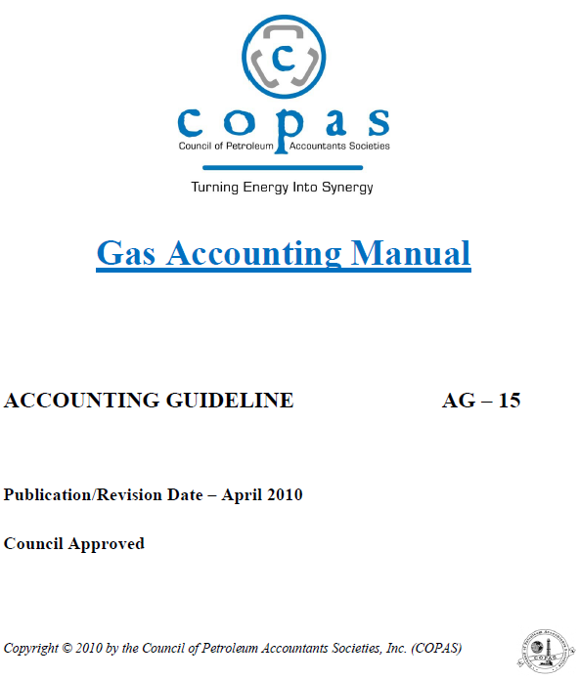
COPAS Gas Accounting Manual AG-15

Slide 8
Table of Contents – AG-15 – Gas Accounting Manual
ACKNOWLEDGEMENTS
FORWARD
INTRODUCTION
GAS MEASUREMENT AND COMPONENT ANALYSIS
PRODUCTION DISPOSITION
TREATING / GATHERING /TRANSPORTATION/ PROCESSING
GAS MARKETING
NATURAL GAS AND NATURAL GAS LIQUIDS VALUATION
ROYALTIES, TAXES, AND OTHER OBLIGATIONS
ACCOUNTING FOR NATURAL GAS AND NATURAL GAS LIQUIDS
REGULATORY HISTORY
ELECTRONIC DATA INTERCHANGE
ACQUISITIONS AND DIVESTITURES
GLOSSARY

Slide 9
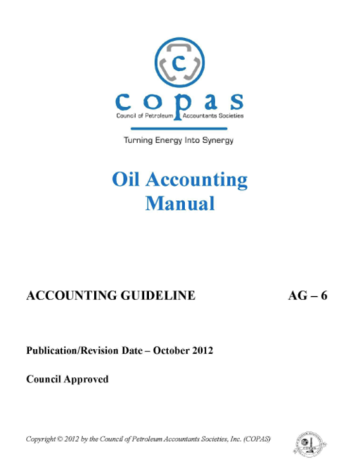
COPAS Oil Accounting Manual AG-6

Slide 10
Table of Content – AG-6 Oil Accounting Manual
FOREWORD
NATURE AND OCCURRENCE OF CRUDE OIL
LEASE ACQUISITION
STORAGE FACILITIES AND SERVICE UNITS
OIL AND CONDENSATE MEASUREMENT STANDARDS
DETERMINATION OF PRODUCTION VOLUMES AND DISPOSITIONS
CRUDE OIL TRADING
PRICING OF CRUDE OIL & CONDENSATE
OWNERSHIP (Division of Interest)
RECORDING AND ACCOUNTING
REPORTING – INTERNAL AND EXTERNAL
OIL IMBALANCE
GLOSSARY

Slide 11
We Need to Know More

Slide 12
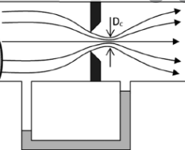
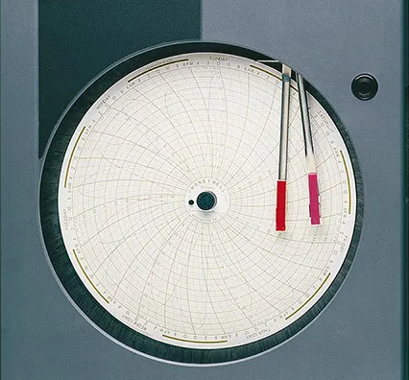
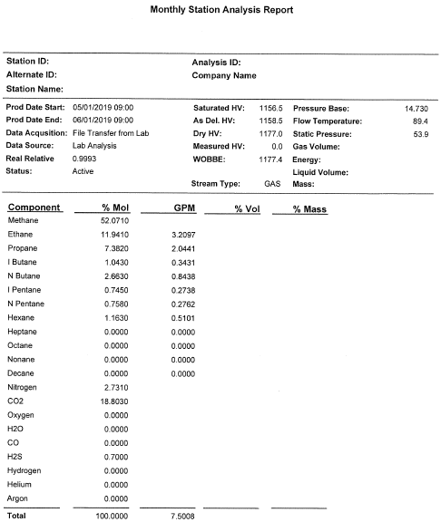
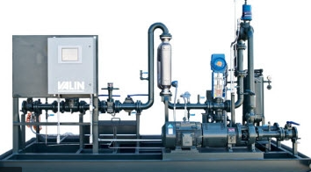
Measurement
Crucial for accurate accounting
  Reporting – For Internal and External Analysis
  Processing – Accurate Creation of Producer Settlement
  Balancing – Inclusion of all Relevant Production
  Assurance – SOX Compliance and Audit Ready
  Value – The Dollars Follow the Molecules and the Contract
  Measurement is followed by Contracts
  Contracts are followed by Dollars

Slide 13
Measurement/Analysis Publications
GPA Midstream Standard 2145-16
  Table of Physical Properties for Hydrocarbons and Other Compounds of Interest to the Natural Gas and Natural Gas Liquids Industry
  Compounds Included:
    methane, ethane, propane, isobutane, n-butane, isopentane, n-pentane, n-hexane, n-heptane, n-octane, n-decane, ethylene, propylene, carbon dioxide, hydrogen sulfide, nitrogen, oxygen, helium, water, hydrogen, carbon monoxide
  Properties included for each Compound:
    Molar Mass, Boiling Temperature, Vapor pressure, Density of Liquids, Density of Ideal Gas, Volumes, Summation Factors, Gross Heating Value, Octane Number

Slide 14
Measurement/Analysis Publications
GPA Midstream Standard 2172-19
  Calculation of Gross Heating Value, Relative Density, Compressibility, and Theoretical Hydrocarbon Liquid Content for Natural Gas Mixtures for Custody Transfer
  Annex A:
    Details of Calculation Methods and Treatment of Water
  Annex B:
    Calculation of Gas Properties
    Calculation for Determining the C6+ Gas Properties
      Assuming 60% Hexane / 30% Heptane / 10% Octane
      Assuming 47% Hexane / 36% Heptane / 17% Octane

Slide 15
Hydrocarbon Basics
Component Short Name Mol Mass Boiling Temperature HV per Gallon
Methane C1 16.0425 -258.66 .059729
Ethane C2 30.0690 -127.44 .063400
Propane C3 44.0956 - 43.80 .091563
Iso Butane IC4 58.1222 10.85 .099630
Normal Butane NC4 58.1222 31.12 .103740
Iso Pentane IC5 72.1488 82.09 .109680
Normal Pentane NC5 72.1488 96.91 .110870
Hexane C6 86.1754 155.68 .115950
Heptane C7 100.2019 209.08 .119570
Octane C8 114.2285 258.12 .122290
Nonane C9 128.2551 303.37 .124650
Decane C10 142.2817 345.42 .126480

Slide 16
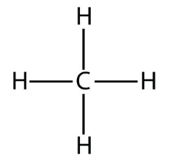
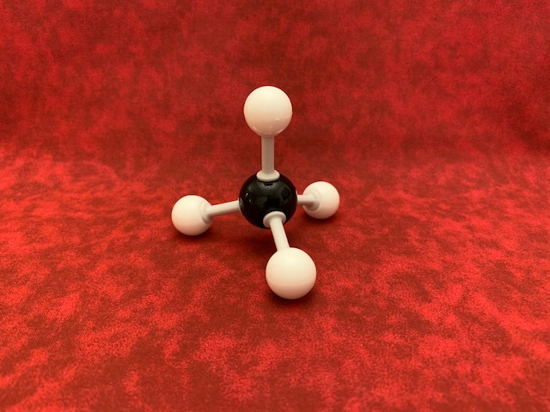
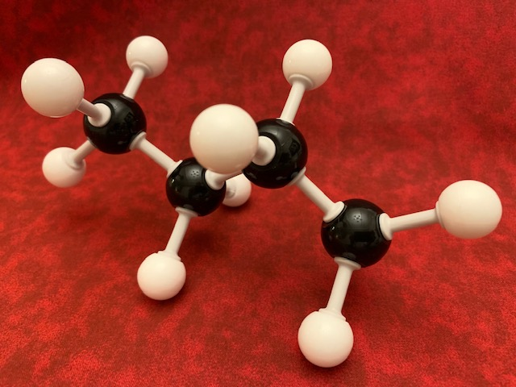
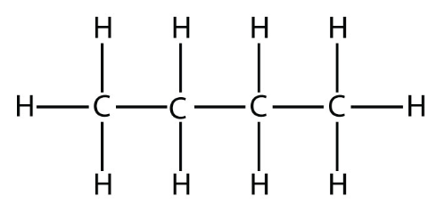
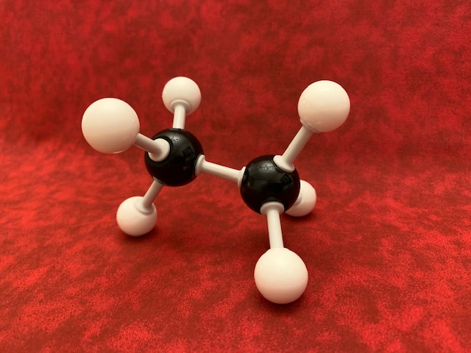
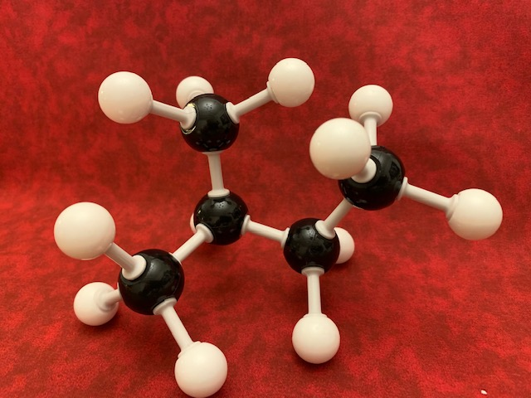
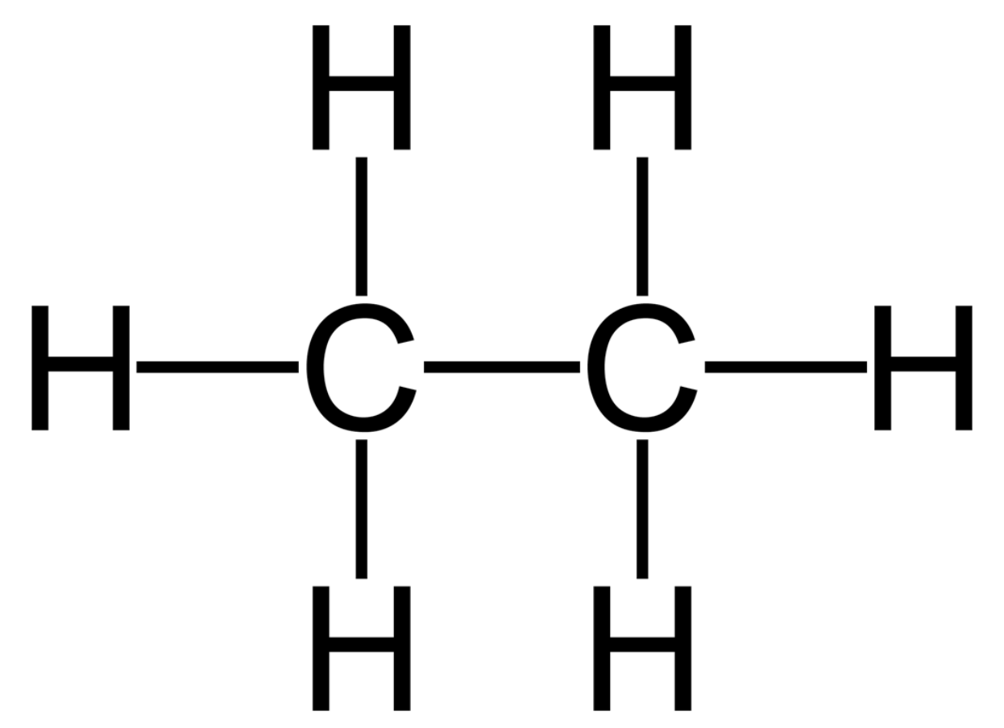
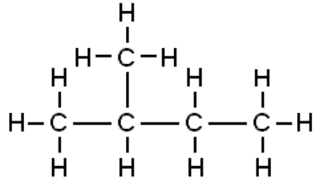
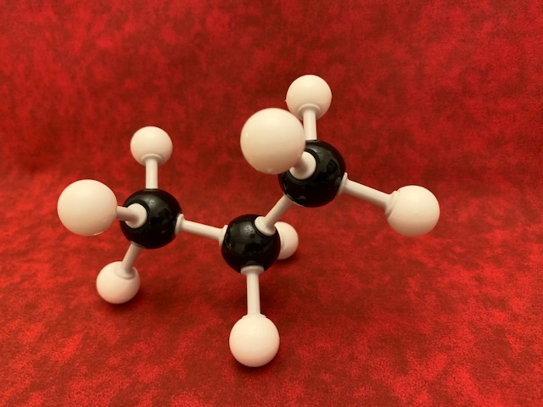
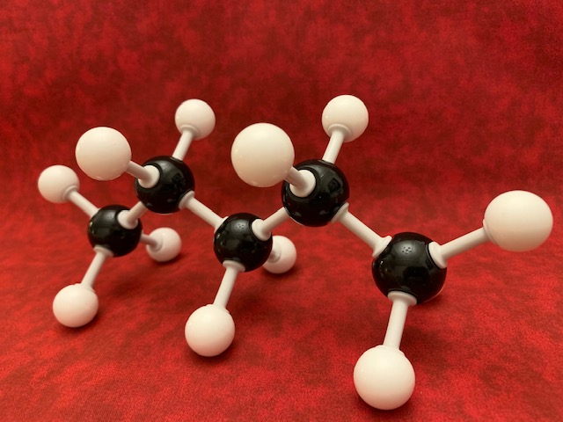
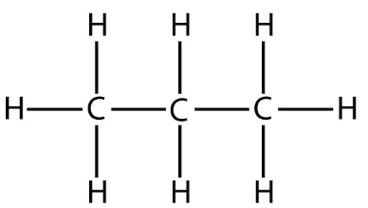
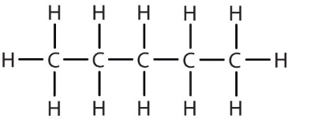
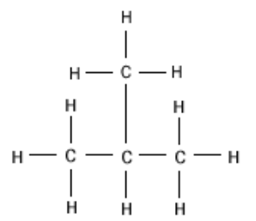
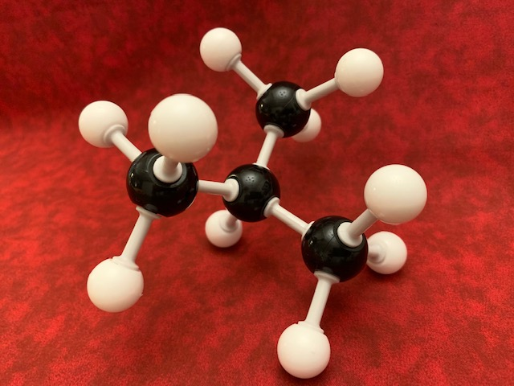
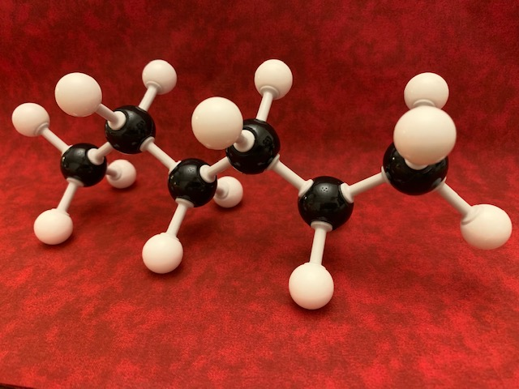
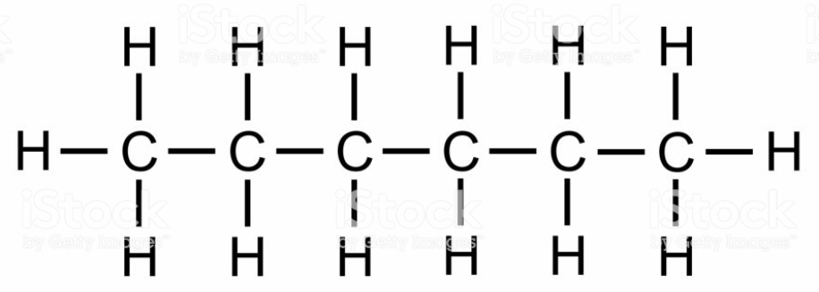
Natural Gas Liquid Molecules
Methane
CH4
Ethane
C2H6
Propane
C3H8
Iso Butane
C4H10
Normal Butane
C4H10
Iso Pentane
C5H12
Normal Pentane
C5H12
Hexane
C6H14

Slide 17
Some Objectives of Pursuing the Future of Midstream Accounting
Increased connection/communication with Upstream (Revenue) Accounting
Clarification of terms and definitions
Upping our game – increase in knowledge and understanding of the “Why” of our own calculations and reports
Increasing Midstream Accounting’s knowledge and understanding of the producer/customer’s needs and assisting the growth of their knowledge and understanding of Midstream reports
Growing our ability to add assurance and provide clarity of the “Black Box” of plant accounting software systems
Activate the Midstream Accountant through Committees within COPAS

Slide 18
COPAS Committees
Standing Committees
Audit Committee
Education Committee
Financial Reporting
Joint Interest Committee
Revenue Committee
Small Oil and Gas Companies Committee
Subcommittees
Emerging Issues Subcommittee (Audit)
Vehicle Rates Subcommittee (Joint Interest)
Employee Benefits Subcommittee (Joint Interest)
Materials Subcommittee (Joint Interest)
Bureau of Land Management Subcommittee (Revenue)
Fed Regulatory Affairs Subcommittee (Revenue)
Midstream / Downstream Committee (Revenue)
Non-Regulatory Subcommittee (Revenue)
State Regulatory Affairs Subcommittee (Revenue)

Slide 19
Activation of the COPAS Midstream (Sub)Committee
Ensure that each COPAS Society has an active Midstream (Sub)Committee
Invite Midstream Accountants to join COPAS
Discuss and address any issues or improvements – within Midstream and Other Groups such as Revenue and Auditing
Activate the National Midstream (Sub)Committee

Slide 20
Upping Our Game

Slide 21

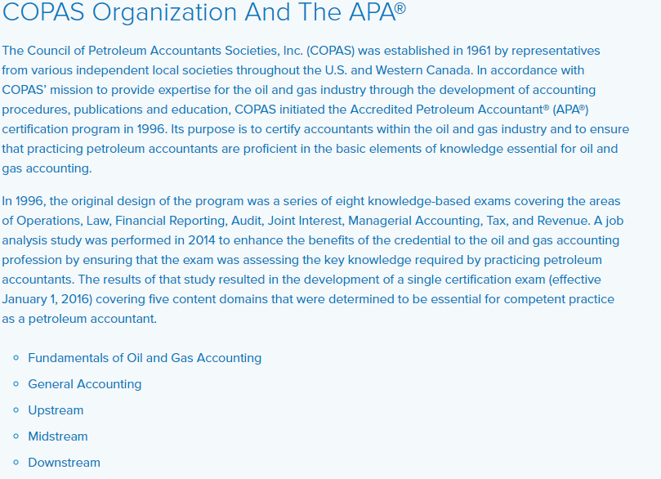

Accredited Petroleum Accountant

Slide 22
    Council of Petroleum Accountant Societies, Inc
    Established 1961
    Organization of the Oil and Gas Industry’s most knowledgeable and influential accounting professionals
    Standard Setter of the Industry

Slide 23
Accreditation
Definition:
  The action or process of officially recognizing someone as having a particular status or being qualified to perform a particular activity
  Necessary to any person or institution in education that needs to prove that they meet a general standard of quality
  The process in which certification of competency, authority, or credibility is presented
  Official recognition of something that meets official standards

Slide 24
How it Makes a Difference
Knowing and Showing I am More than my Mastery
Facilitates Better Understanding and Communication within the Industry

Slide 25
Pursuing the Future of Midstream Accounting
Get COPAS Midstream/Downstream (Sub)Committees activated
Improved Connection/Communication - Clarification of terms and definitions
Improved Connection/Communication with Upstream (Revenue) Accounting
Increase in knowledge and understanding of our own calculations and reports
Increase our knowledge and understanding of the customer needs and their growth in knowledge and understanding of Midstream
Increase our ability to add assurance and provide clarity of the “Black Box” of plant accounting software systems
Keep Learning and Growing!

Slide 26
Questions?

Slide 27
History of the Accredited Petroleum Accountant Program
1996
  8 Exams
  Operations, Law, Financial Reporting, Audit
  Joint Interest, Managerial Accounting, Tax, Revenue
2014
  1 Exam – 5 Content Domains
    Fundamentals of Oil and Gas Accounting 13%
    General Accounting -22%
    Upstream – 38%
    Midstream – 17%
    Downstream – 10%

